Slide 1
Maximize On Contract Growth: Strategies for Long-Term Sustainable BD
www.ostglobalsolutions.com

Slide 2
About OST Global Solutions
We've Won Our Clients Over $26 Billion in Government Contracts Since 2005
BUSINESS DEVELOPMENT, CAPTURE, AND PROPOSAL CONSULTING
Build Portfolio of Indefinite Delivery Vehicles
Develop Opportunity Pipelines
Capture Opportunities
Win Proposals
Optimize Your Processes
REGISTERED APPRENTICESHIP IN GOVERNMENT BUSINESS DEVELOPMENT; 18 COURSES IN ALL ASPECTS OF FEDERAL BUSINESS DEVELOPMENT
SBIR/STTR Proposal Lab for Maryland and Alabama
Certified Business Developer
Certified Capture Manager
Certified Proposal Manager
Certified Proposal Coordinator
Certified Proposal Writer

Slide 3
The “Big Picture”
Just like the Flywheel concept from Jim Collins’ Good to Great, every step in the BD Lifecycle contributes to building momentum that drives sustained, organic growth
Step 9.0, On-Contract Growth and BD During Project Execution is where momentum turns into sustained success: relationships deepen, opportunities expand to ensure long-term growth and customer satisfaction
Begin Business Development Process
Capacity building to do business with the government
Conduct Strategic Business Development Planning Session
Perform Market Research
1.0
2.0
3.0
Market to Agencies & Partners
Enough Info to Make Decisions?
Yes
No
4.0
Yes
Create OCG and Support BD During Project Execution
Fill & Manage the Opportunities Pipeline
Check for Strategic Fit
9.0
5.0
Prepare Proposal
Conduct Capture
Qualify Each Individual Opportunity
8.0
7.0
6.0

Slide 4
Why OCG: Businesses Must Grow or They Die
How Businesses Grow
Why Businesses Must Grow
How Growth Helps Customers
New work with existing customers
Solidify relationships, secure long-term bookings, backlog
Drive results through IR&D, process improvement, better staff
1
Organic
New work with new customers, same agency
Expand footprint, enhance capabilities and resources
Support evolving needs, introduce proven solutions to new clients
2
New work with new customers, new agencies
Diversify to reduce reliance on existing markets
Tailor innovative solutions to new market segments
Inorganic (M&A)

Slide 5
Flavors of OCG
Scope Modifications How Else Can We Assist? More people, deliverables, objectives, & activities
New Competitive Opportunities to add to the pipeline
Requirements Contract with Defined Scope or Single Award IDIQ
Innovations,
IR&D
Support in winning business (Capture and Proposals)
Identified Work Moved to Other Company Contracts (Non-Competitive)
New Task Orders
More Cost-Effective and Faster to Award – Avoids Lengthy and Expensive Procurement Processes
Competitions Driven by Superior Customer Insight – The Best-Informed Wins

Slide 6
What Lack of OCG Culture Looks Like (1)
Scenario 1: Missed UI Improvement
Customer: "You know, way before your company took over this project, I’ve been struggling with this user interface. It’s so clunky and outdated. It takes twice as long to get anything done, and I’m not even sure we’re accessing all the data we could be."
Project Person: "I hear you. Honestly, if we could just redesign the UI, we’d probably be able to unlock a lot more capabilities and access more data. The system is powerful, but the interface really holds us back. It could be so much easier to use."
Customer: "Exactly! It’s frustrating because I know the potential is there, but we’re stuck with this outdated system."
Project Person: "Yeah, it’s a shame. I’ve thought about what we could do to improve it, but… well, we’re just kind of stuck with it, aren’t we, given the current project scope?"
Customer: "Unfortunately, yes. But it’s good to know I’m not the only one feeling this way about this UI."
Project Person: "Thanks for trusting me with your frustration. I am always here if you want to discuss anything in confidence."

Slide 7
What Lack of OCG Culture Looks Like (2)
Scenario 2: Forgotten White Paper
Project Person (thinking to themselves): "This new technology we’ve been working on could really solve a lot of issues for our customer. If we developed a white paper, we might be able to present this as a new capability. But I’ve got so much on my plate right now…"
(A colleague walks by and notices the project person deep in thought.)
Colleague: "Hey, you look like you’re mulling something over. What’s up?"
Project Person: "I was just thinking about a new approach we could take for the customer. It’s something that could potentially be big, but I’m swamped with current tasks. I’m not sure whom I should even talk to about it, and honestly, I don’t have the bandwidth to push it right now."
Colleague: "It sounds interesting! Maybe you could bring it up in the next team meeting?"
Project Person: "Yeah, maybe. But I don’t know… I’ve got so much going on. I think I’ll just put it aside for now and revisit it when things calm down—if I remember."

Slide 8
How Do You and Your Program Staff Feel About BD and Sales?
When Your Program Staff Think About Sales, They...
Get a rush of adrenaline – it’s go time! They could sell a mop in a room full of carpets.
They will do what they have to do, but it’s not their favorite.
They are okay with it, as long as they don’t have to actually talk to customer about money.
Break out in a cold sweat. It gets hot in room when we discuss it. They would rather wrestle an ice golem.
Suddenly remember they have an urgent customer meeting. Like, right now.
Hard selling is when your program staff push the OCG regardless of whether it’s the right fit.
Consultative selling is about helping the customer make the best decision, even if it means telling them, 'This isn’t right for you.’
Notes:
Many people in program management or project management didn’t expect to be in sales, but sales are about solving problems and helping people.

Slide 9
OCG Process
1
2
3
Cross-Functional Collaboration
Customer Engagement
Process Documentation, Knowledge, & Tools
Enabling
Confirm & Capture Growth Leveraging Integrated Project, BD, and Technical Teams
Develop, Update, & Share Standard Processes, Resources, & Templates
xx
Understand Needs & Challenges, Identify Growth Opportunities
4
5
6
7
Culture of Innovation & Flexibility
Training & Development
Incentives & Recognition
Performance Monitoring & Feedback
Supporting
Encourage Teams to Adapt to Changes and Propose New Ideas
Build and Expand OCG Skills & Knowledge
Motivate All Personnel to Engage in OCG Activities
Drive Continuous Improvement

Slide 10
Top Barriers to Thinking of OCG as Part of Program Staff’s Job
Reluctance to sell:
Cultural mindset and role perception (viewing BD as outside of scope – OCG is BD’s job)
Negative perceptions of OCG (BD seen as superficial compared to technical work)
Concerns about overstepping professional and ethical boundaries with sales pitches
Giving up quickly if customer seems uninterested
Protective behaviors due to fear of damaging an established customer rapport
Singular focus on execution so there is no time to dedicate to program growth
Limited knowledge of broader company capabilities and low OCG acumen
Roadblock
ahead
Notes:
Focus on how to help program staff overcome the barriers

Slide 11
Clarify for Staff How OCG Aligns with Mission Outcomes
Identifies and implements improvements, innovations, and expansions
Fosters trust and collaboration by aligning our initiatives with the customer’s priorities
Aligns company’s growth efforts with customer’s evolving needs
Mission
Anticipates and addresses challenges proactively
Ties our contributions to mission-critical measurable outcomes
Drives continuous improvement

Slide 12
Helping Program Staff Overcome the Reluctance to Sell
OCG does not solely benefit the company or maximizes revenue, but supports the mission and ensures project success
It is needed so that:
The project can be implemented smoothly without unforeseen risks
Project personnel stay informed about potential needs and address them proactively
There is time to carefully plan and execute the program, avoiding rushed decisions that could lead to poor results
Your project personnel are not “selling” in the traditional sense
They are identifying and solving problems the customer may not even realize they have
They are offering well-thought-out solutions that will make their mission easier to accomplish

Slide 13
Selling Out the Contract
A PM’s job is to fully realize the potential of the contract in terms of revenue, bookings, and backlog
Selling out the contract = success for all:
Secure additional work to reach the contract’s ceiling.
Expand services based on evolving customer needs.
Ensure full utilization of budgeted resources, avoiding any potential de-obligation of funds.
The government has already budgeted for the contract and invested into putting this contract in place – ensure every dollar budgeted is put to its most impactful use, to fulfill mission goals
By optimizing resources and expanding services within the existing contract, agencies avoid the costs and delays of new procurements
Selling out contracts leads to continuity in mission support, minimized risk, and greater value to the government

Slide 14
The Rest of the Solution
Understand On-Contract Growth (OCG) opportunities and process for ensuring long-term business success of your company.
Identify obstacles to OCG.
Drive the culture of building and sustaining meaningful customers engagements to uncover potential growth opportunities.
Teach your staff OCG skills.
Collaborate cross-functionally to maximize OCG.
Develop an OCG action plan.
Gather intelligence to address customer needs.
Frame problems and solutions in mission-centric terms.
Address customer pain points and align solutions with mission priorities.
Identify the available support structures, knowledge, and tools that facilitate OCG efforts within the project teams.
Turn your entire workforce into a salesforce!

Slide 15
Next Steps & Resources
Reach out to hear more about OST’s On Contract Growth: BD for Project Personnel corporate training and support.
Schedule time to discuss your BD, Capture, and Proposal needs:
https://calendly.com/ostglobalsolutions/bdconsulting?month=2023-09
We regularly publish updates to major contracts through our newsletter and blog:
Blog: https://www.ostglobalsolutions.com/blog/
Newsletter sign up: https://www.ostglobalsolutions.com/tag/email/
Sign up for our newsletter and schedule an appointment

Slide 16
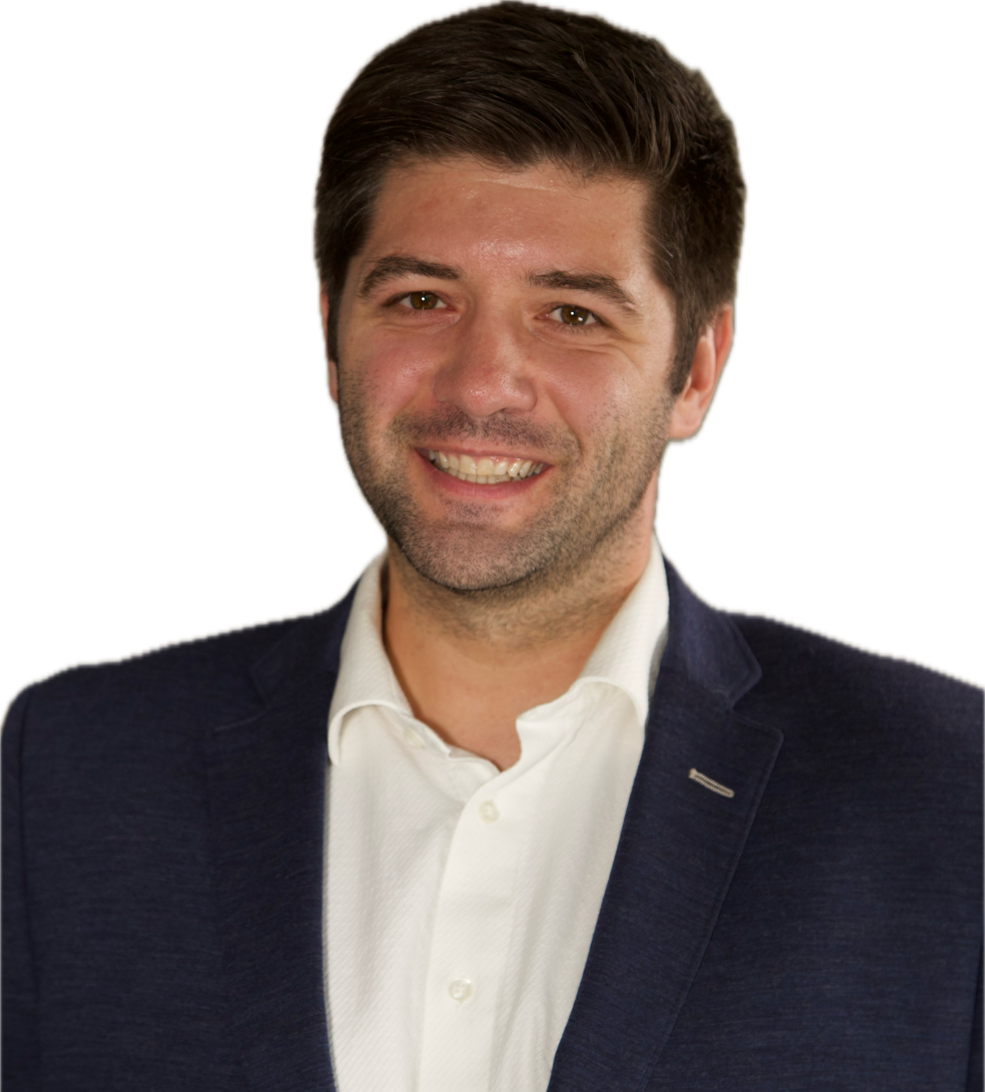
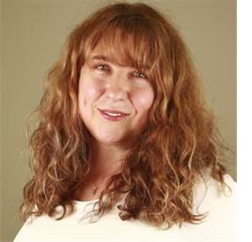
Let’s Partner in Winning Business
David Huff
CEO
c: 513-316-0993
o: 301-384-3350
e: dhuff@ostglobalsolutions.com
Olessia Smotrova
CSO
c: 240-246-5305
o: 301-384-3350
e: osmotrova@ostglobalsolutions.com
www.ostglobalsolutions.com

