Slide 1
CDAO: Advancing Artificial Intelligence Multiple Award Contract (AAMAC)
19 December 2024

Slide 2
OST’s AAMAC Support
OST specializes in winning these types of large, strategic IDIQs
We offer:
Scorecard review
Wargaming to maximize score
Teaming support
Proposal management
Proposal writing and editing for the narrative portions
Compliance Reviews
Graphics and DTP
Schedule a call to learn more about our support

Slide 3
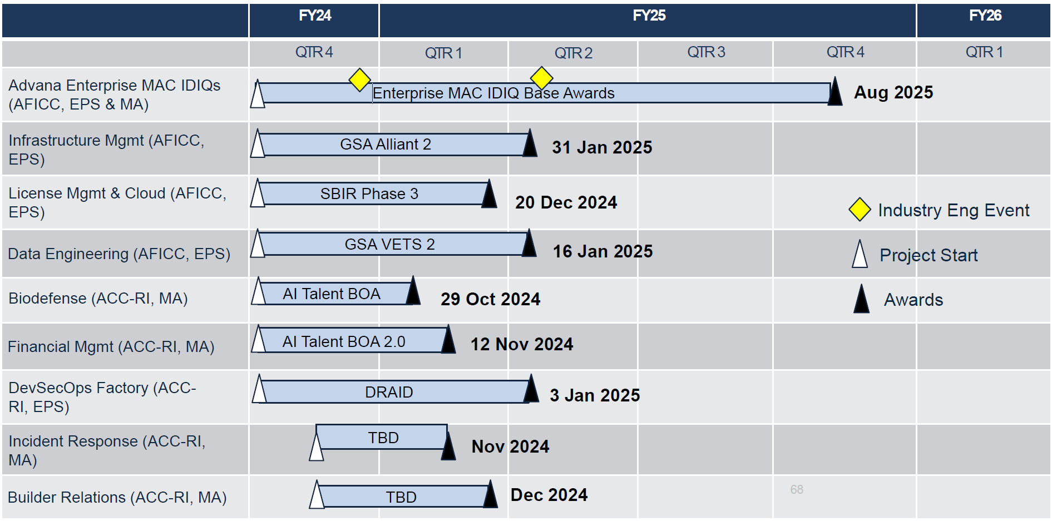
AAMAC’s Acquisition Timeline

Slide 4
Industry Day: AAMAC Overview
Acquisition Strategy: Unpriced IDIQ
Target Range of Initial Awards: 50 – 70 IDIQ awards
Contract Type: Any contract type authorized based on order requirements
Scope: 29 Focus Areas covering a wide range of data, analytics, AI, & platform services
Total Value: $15B combined ceiling
Who Can Use: Any DoD organization
Est. Ordering Periods:
Basic: 1 August 2025 – 31 July 2030
Option: 1 August 2030 – 31 July 2035
Competition Type:
IDIQ awards will be competed using Full and Open competition
Future orders will be competed via one unrestricted pool and one or more small business pools

Slide 5
AAMAC Changes on 20 Nov 2024
Instructions:
All feedback should be provided via the AAMAC Draft RFP form: https://forms.osi.apps.mil/r/Ew1P7SsrwF-
Responses must be received no later than Friday, 20 December 2024 @ 12PM Eastern.
Must use: AAMAC Draft RFP Feedback (Page 1 of 4)
Note that since holding the Advana Industry Day on 18 September and receiving/reviewing over 300 responses to our AAMAC sources sought in October, we have made the following changes:
The AAMAC Statement of Work was retitled as AAMAC General Requirements, to avoid potential confusion with order work statements.-
The 29 AAMAC Focus Areas briefed at the Advana Industry Day were removed, as they were causing confusion.
For simplicity's sake, the Government condensed the original set of 20+ Ability To statements, resulting in a total of 8 Ability To statements that are mutually exclusive and collectively exhaustive in covering AAMAC program needs.
To adequately capture and enable relative weighing of all AAMAC technical experience and capability areas, the Government adopted the Highest Technically Rated Offeror (HTRO) methodology and created a HTRO self-scoring matrix (Attachment 8).

Slide 6
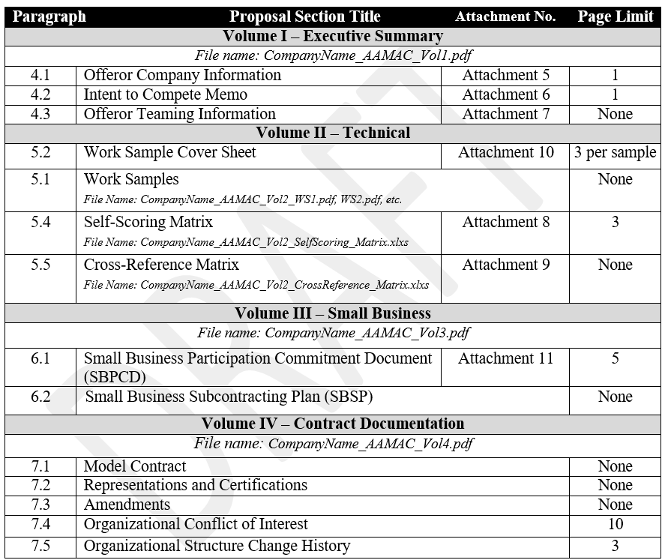
Draft RFP: Proposal Organization

Slide 7
Draft RFP Evaluation Criteria
The Government will evaluate Volume I – Executive Summary proposals for ITO compliance.
The Government will then evaluate Volume II – Technical and Volume III – Small Business proposals using the following two (2) evaluation factors:
(1) Factor 1: Technical Capability (Volume II) – scorecard
(2) Factor 2: Small Business Participation (Volume III)
Using the Highest Technically Rated Offeror (HTRO) methodology
The Government will establish a Minimum Technical Threshold Rating (MTTR) by:
Ranking the highest 80% of the highest small business Offeror’s Self-Score rating
Ranking the highest 80% of the highest other than small business Offeror’s Self-Score rating
Awards will go to all Offerors who each have the 80% highest Government-validated Self-Score rating.
The Government will unilaterally adjust down scores that are not properly validated, justified, or substantiated.

Slide 8
Draft RFP: Rules for Scoring Points
The Offeror shall submit up to 12 work samples (contracts/orders) which demonstrate their technical capability and experience under the criteria at paragraphs 5.4.1 – 5.4.23.
Indefinite delivery contracts or similar ordering vehicles are not acceptable proof of technical capability and experience, and shall not be provided as a work sample.
No more than 3 work samples may be submitted by a Teaming Partner/Subcontractor.
Offerors may not cross-team on more than 1 proposal submitted in response to this solicitation. Offerors shall not participate as a Prime Offeror, JV member, teaming partner, or subcontractor on more than 1 proposal submitted in response to this solicitation.
The work samples shall consist only of official documentation associated with or generated during performance of the referenced contract/order, which may include the PWS, SOW, CDRLs, etc. For each work sample, the Offeror shall also include the fully signed cover page for the particular contract/order.
Work samples shall fall into one of the following categories, as specified within the criteria at paragraphs 5.4.1 – 5.4.23:
Category 1: Prime Offeror work samples shall be used.
Category 2: Teaming Partner/Subcontractor work samples may be used.
Unless otherwise defined within the criteria at paragraphs 5.4.1 – 5.4.23, work sample performance shall have begun within 3 years of this solicitation’s initial issuance date, and all required work at least 50% completed.

Slide 9
Draft RFP: 12 Work Samples
Criterion | Eligible Category | Maximum Points
Criterion No. 9: Prototype Software Projects | Category 1 only | 20,000
Criterion No. 1: Systems Management, Architecture, and Engineering | Category 1 and Category 2 | 10,000
Criterion No. 5: Artificial Intelligence/Machine Learning (AI/ML) Solutions | Category 1 and Category 2 | 10,000
Criterion No. 6: Cybersecurity | Category 1 and Category 2 | 8,000
Criterion No. 2: Software Platforms and Systems | Category 1 and Category 2 | 6,000
Criterion No. 3: Data Solutions | Category 1 and Category 2 | 6,000
Criterion No. 7: Managed Services | Category 1 and Category 2 | 6,000
Criterion No. 8: Digital Transformation | Category 1 and Category 2 | 4,000
Criterion No. 4: Analytic Solutions | Category 1 and Category 2 | 2,000

Slide 10
Draft RFP: Other Points Available
Note: Small business may but are not required to score themselves on all of these criteria – OTSB are required to score themselves on every criterion
Many of the points are scored from “of the work samples submitted”
Criterion | Eligible Category | Maximum Points
Criterion No. 10: Highest Value Contract | Category 1 only | 1,000
Criterion No. 11: User Growth | Category 1 only | 4,000
Criterion No. 12: Peak Number of Users Supported | Category 1 only | 3,000
Criterion No. 13: Authorizations to Operate | Category 1 only | 1,000
Criterion No. 14: Continuous/Ongoing Authorizations to Operate | Category 1 only | 15,000
Criterion No. 15: Facility Clearance | Category 1 only | 3,000
Criterion No. 16: CMMI-SVC Level 3 | Category 1 only | 500
Criterion No. 17: CMMI-DEV Level 3 | Category 1 only | 500
Criterion No. 18: ISO/IEC 27001 | Category 1 only | 500
Criterion No. 19: ISO/IEC 20000 | Category 1 only | 500
Criterion No. 20: Peak Number of Full-Time Employees | Category 1 only | 3,000
Criterion No. 21: Retention Rate | Category 1 only | 5,000
Criterion No. 22: Cleared Personnel | Category 1 only | 2,000
Criterion No. 23: Overseas Placement | Category 1 only | 2,000

Slide 11
Next Steps
& Resources

Slide 12
Next Steps & Resources
We provide gap analysis, color reviews, and proposal support.
Q&A updates can be found here: SAM.gov
We have a subcontractor portal where you can upload your capabilities for this opportunity and others:
https://www.ostglobalsolutions.com/teaming-partner-match-portal/
We are happy to schedule time to discuss your AAMAC bid:
https://calendly.com/ostglobalsolutions/bdconsulting?month=2023-09
We regularly publish updates to major contracts through our newsletter and blog:
Blog: https://www.ostglobalsolutions.com/blog/
Newsletter sign up: https://www.ostglobalsolutions.com/tag/email/
Sign up for our newsletter and schedule an appointment

Slide 13
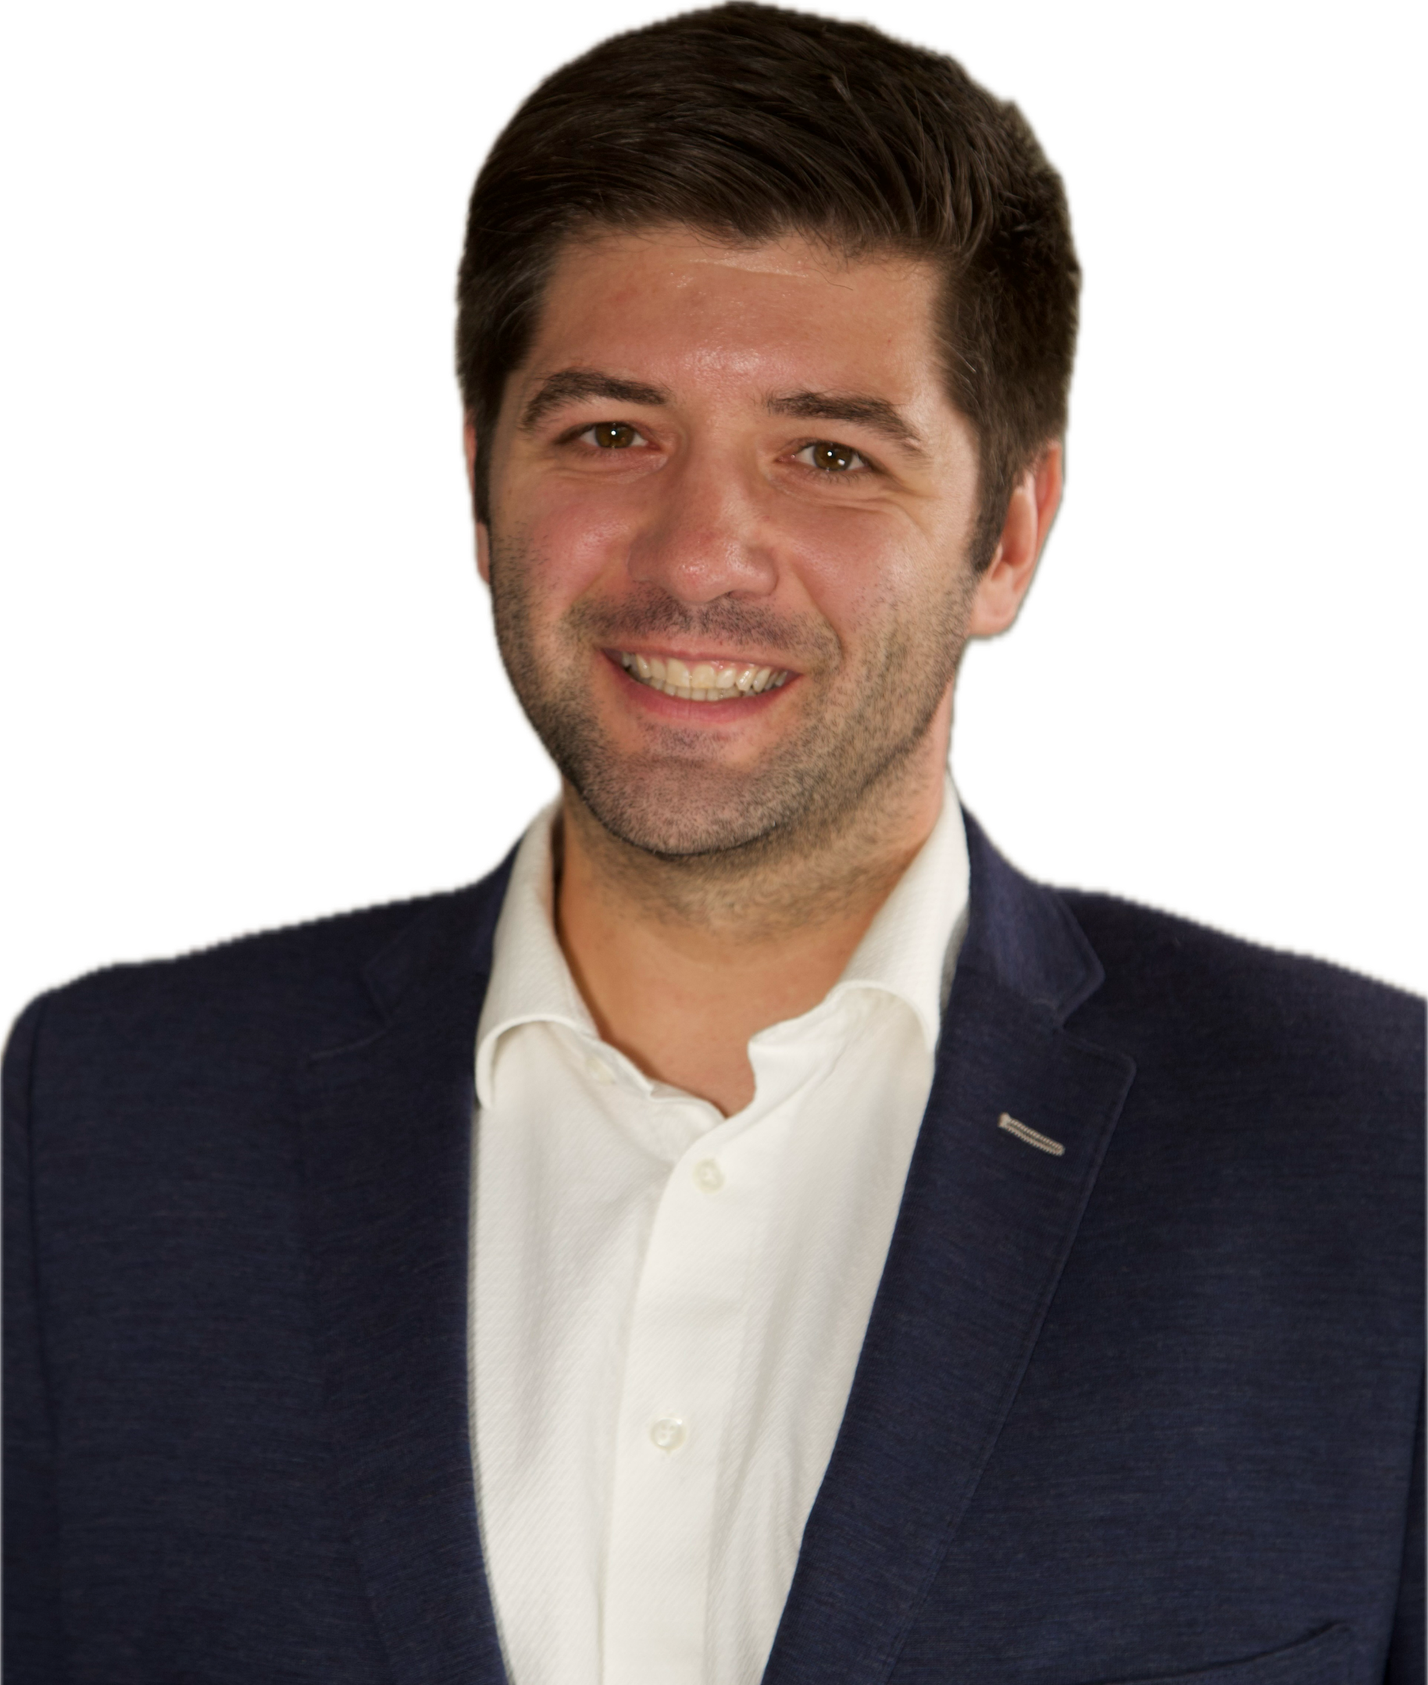
Let’s Partner in Winning Business
David Huff
CEO
c: 513.316.0993
o: 301.769.6602
e: dhuff@ostglobalsolutions.com
www.ostglobalsolutions.com

